Slide 1

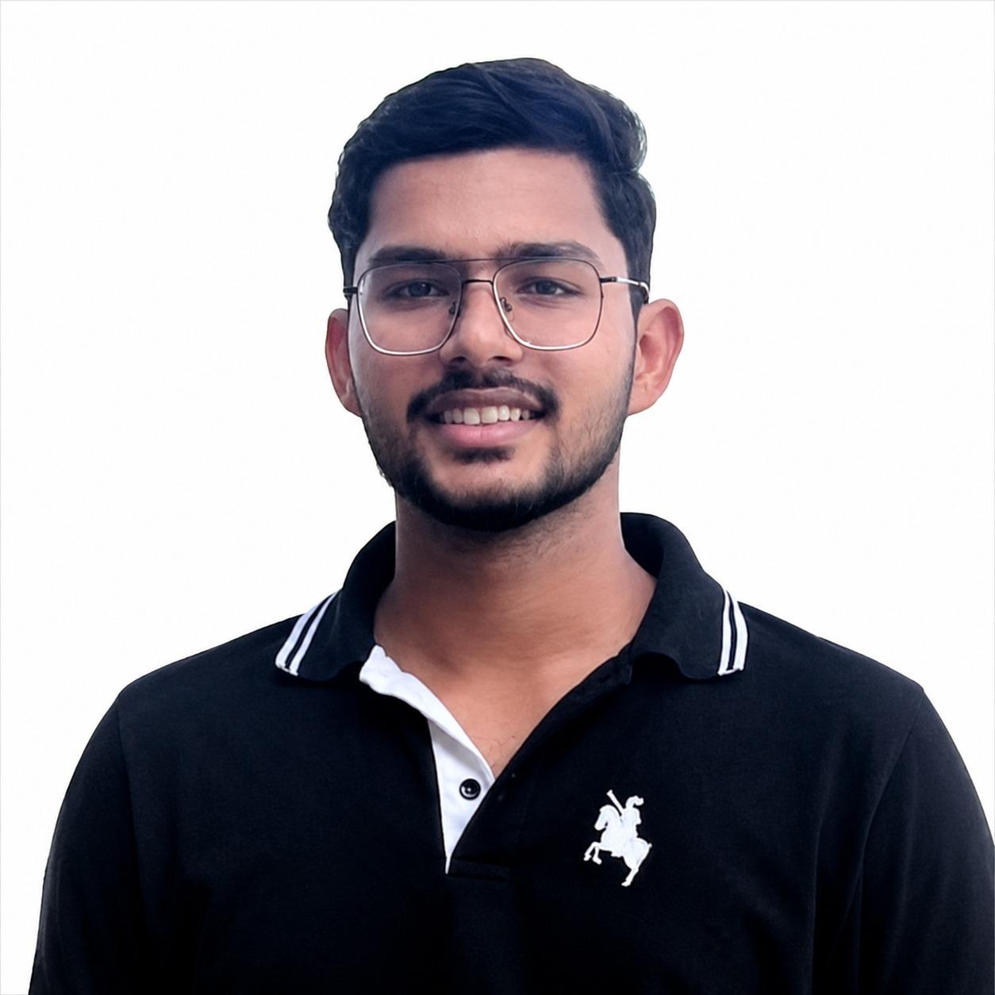
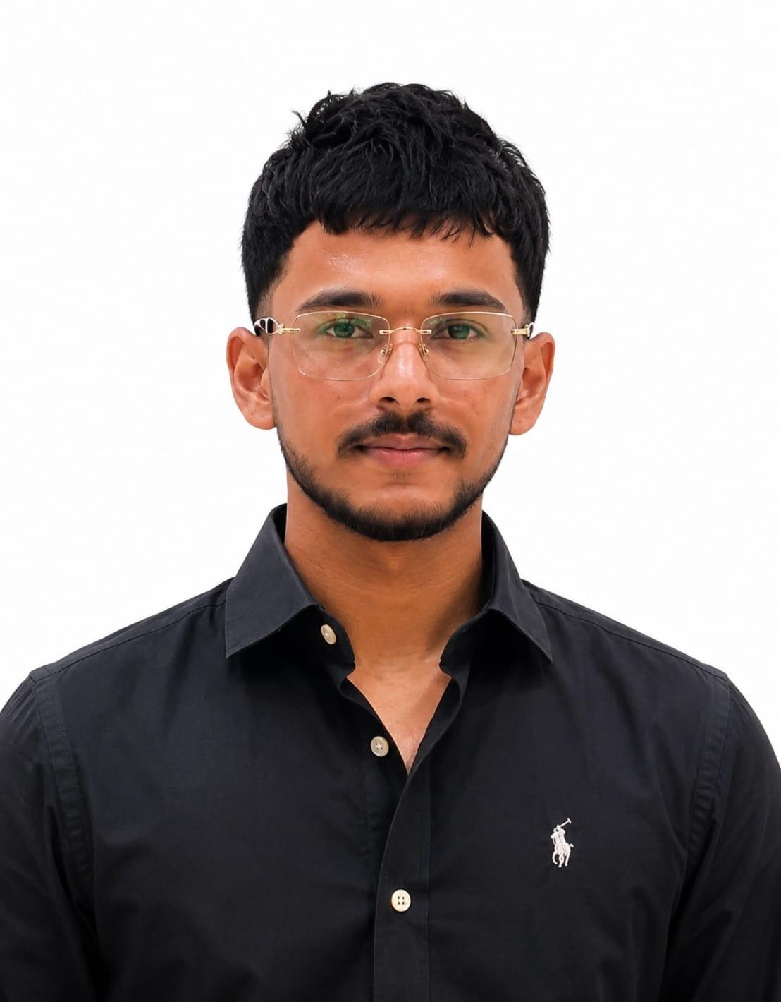
Department of Computer Application
Student Achievements (2025-26)
Name : Mr. Dhruv
Batch: 2024-2027
Detail about Achievement: Google Student Ambassador for the year 2026
Name : Mr. Harsh Singla
Batch: 2024-2027
Detail about Achievement: Campus Ambassador for E-Cell, IIT Bombay

Slide 2
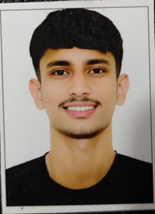
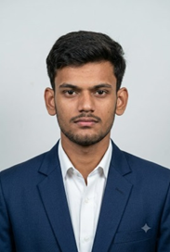
Department of Computer Application
Student Achievements (2025-26)
Name : Mr. Raman
Batch: 2024-2027
Detail about Achievement: selected in Indian Army 2026.
Name : Mr. Sumit kumar Mishra Batch: 2023-2026
Detail about Achievement: selected in Indian Navy 2026

Slide 3
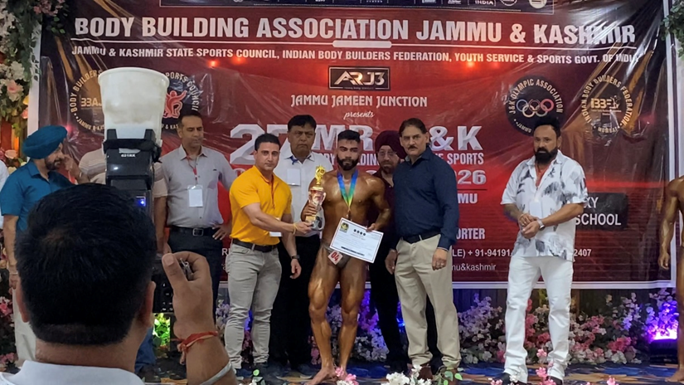
Department of Computer Application
Student Achievements (2025-26)
Name : Mr. Rajan
Batch: 2024-2027
Detail about Achievement: won prizes in bodybuilding and powerlifting- Mr. J&K 2026 (27th Edition): 3rd Place , Mr. North India 2026: 2x Silver Medalist , Mr. Asia 2026: 5th Position (January 19, 2026)

Slide 4
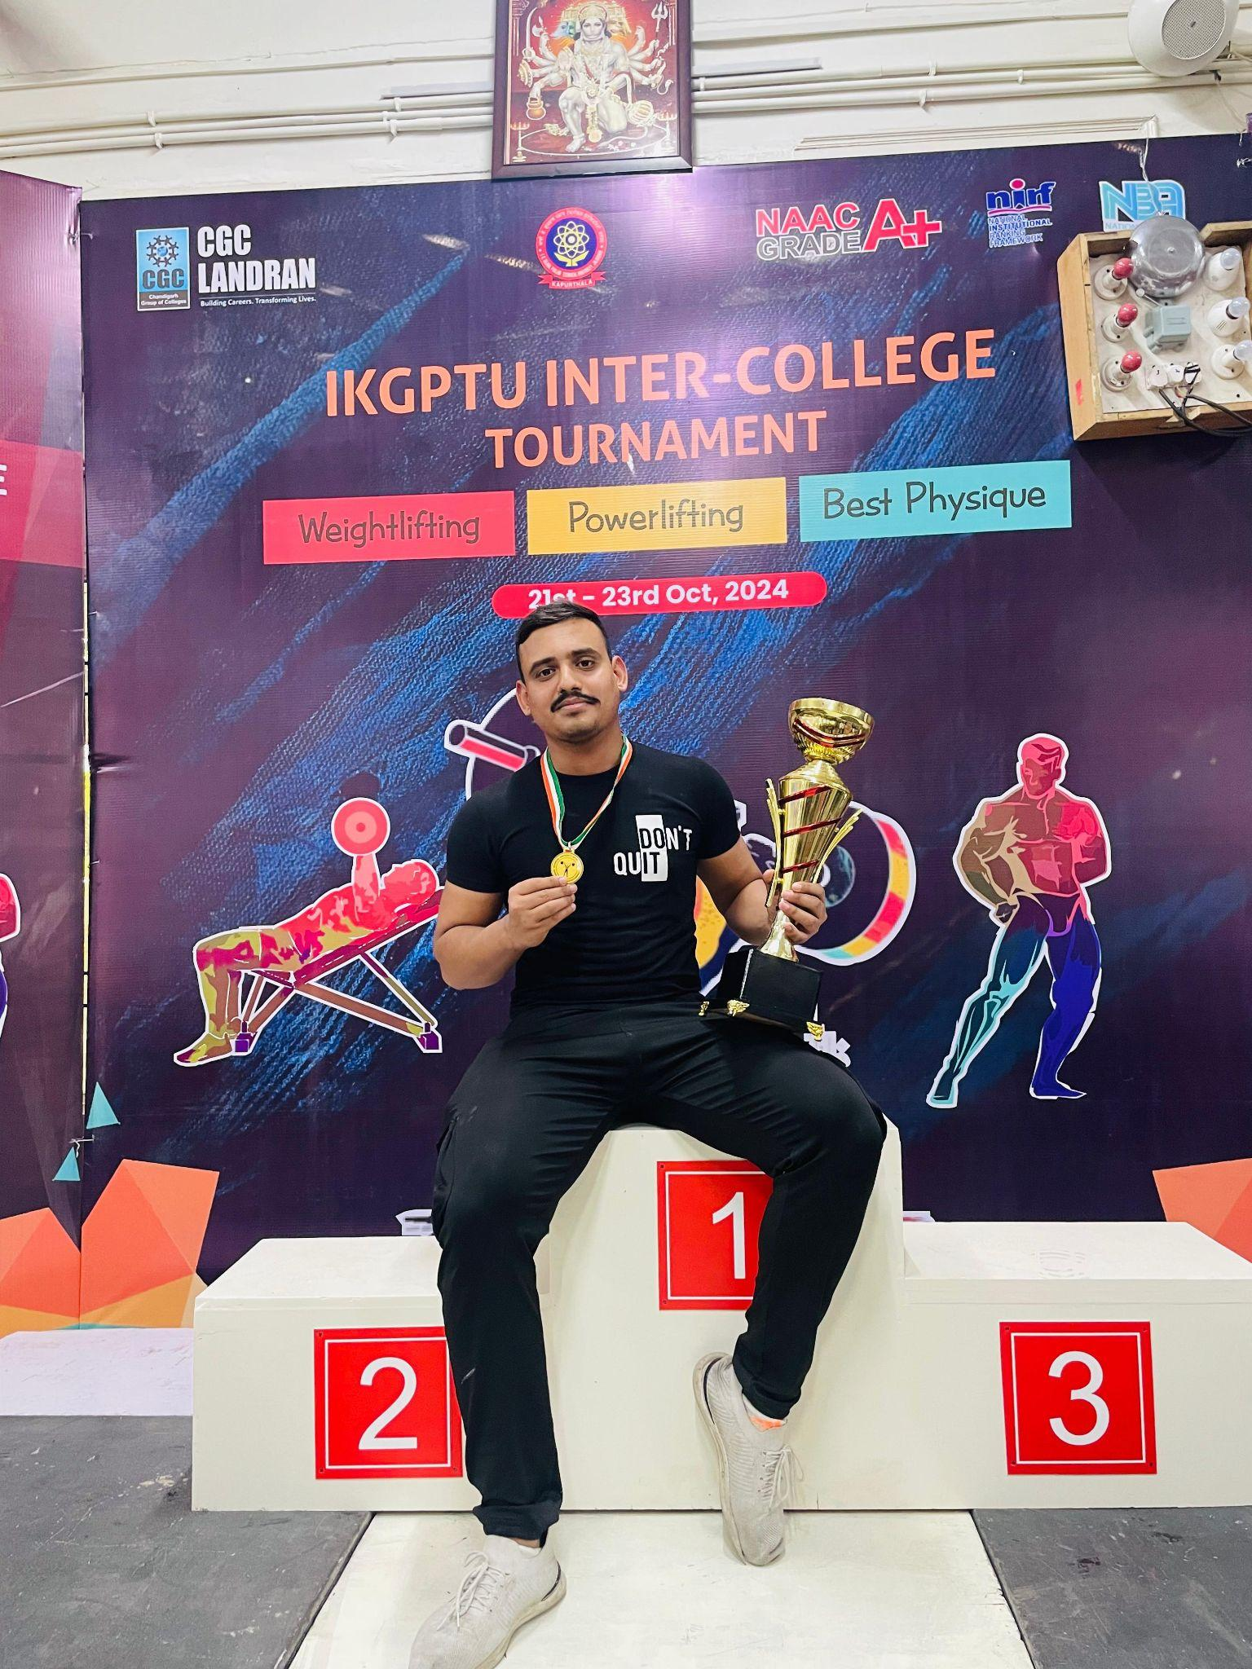
Department of Computer Application
Student Achievements (2025-26)
Name : Mr. Saurabh katoch
Batch: 2023-2026
Detail about Achievement: won 1st Position in Chandigarh State
Weight lifting by Chandigarh Amateur weightlifting

Slide 5
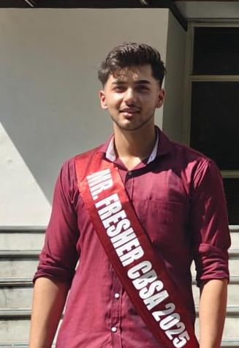
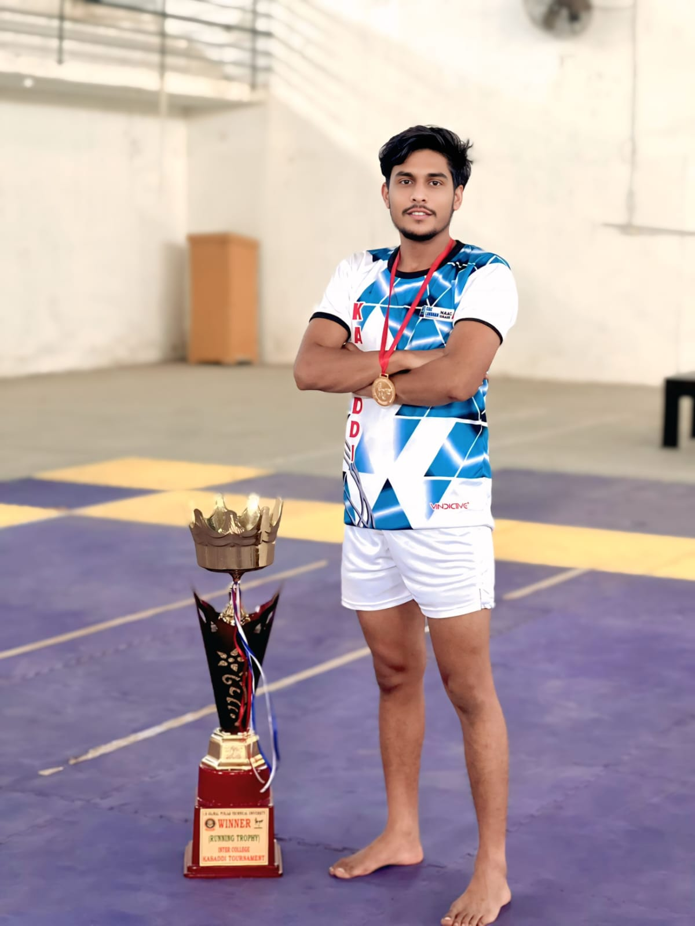
Department of Computer Application
Student Achievements (2025-26)
Name : Mr. Sammual
Batch: 2025-2028
Detail about Achievement: won 1st Runners up Mr. Fresher in Jashan 2025
Name : Mr. Sahil
Batch: 2025-2028
Detail about Achievement: won 1st Position in Inter college kabaddi tournament

